Slide 1




ALTERYX
NYC DATATHON 2024
HOUSING PRODUCTION BY PROJECT
BY
HANISH CHALICHAM

Slide 2



PROBLEM STATEMENT
The main objective is to analyze the existing housing production programs, identify key inefficiencies, and propose strategic solutions that can inform policy adjustments and enhance the effectiveness of future housing initiatives.
In recent years, the rising demand for affordable housing has outpaced supply, leading to a critical shortfall in available family units. Despite numerous programs aimed at addressing this issue, there remains a significant gap in meeting the diverse needs of the population, particularly for seniors and those requiring accessible living accommodations.

Slide 3
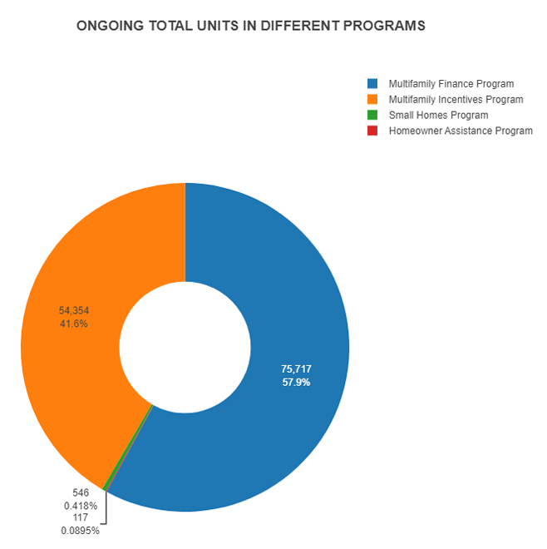
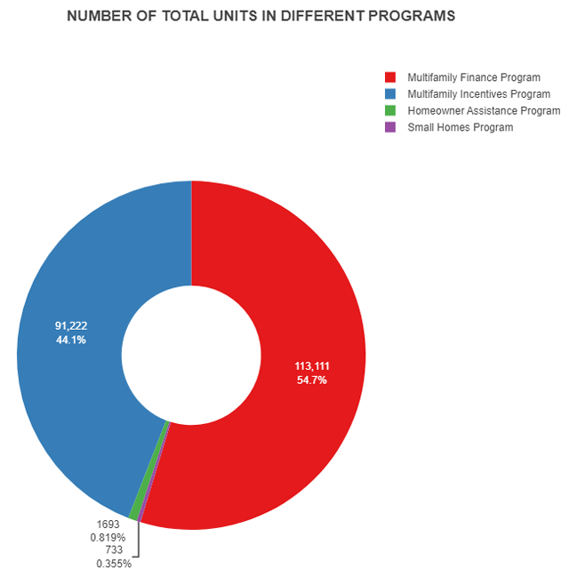
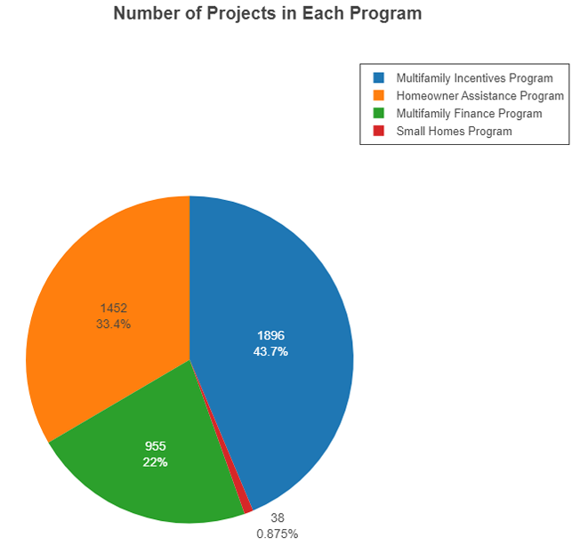
Housing Production Programs

Slide 4
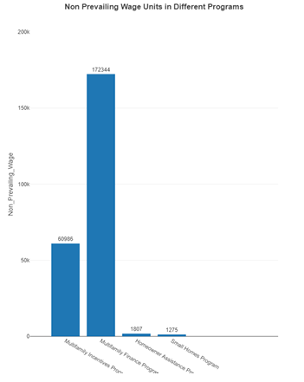
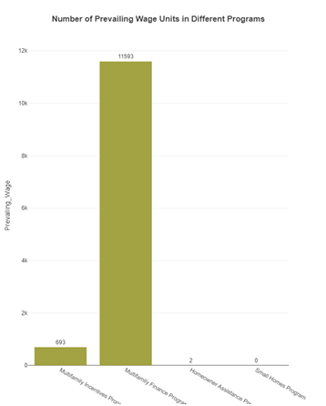
Efficiency of Small-Scale Projects
The Small Homes Program has been successful in producing housing units without the use of prevailing wage. This might indicate that small-scale projects can operate more efficiently and could be a model for future programs.

Slide 5
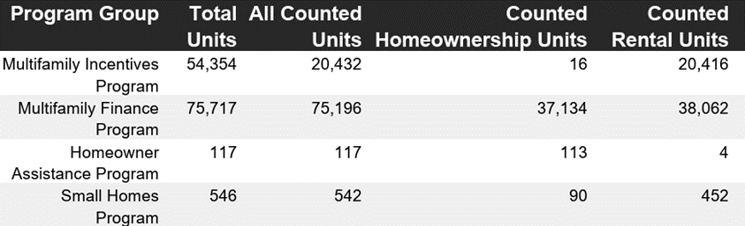
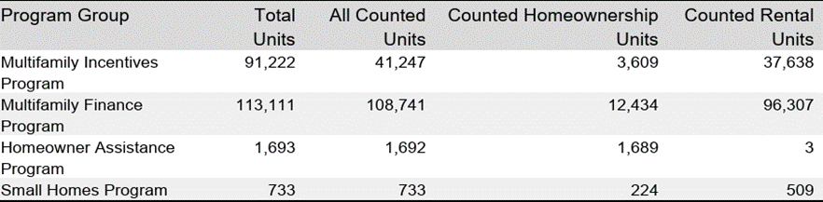
HOMEOWNERSHIP
vs
Rental Strategy
ONGOING
VS
COMPLETED
•The significant skew towards rental units suggests that current programs may be strategically focusing on rental housing. This could be due to faster turnover or a higher demand in the rental market.

Slide 6
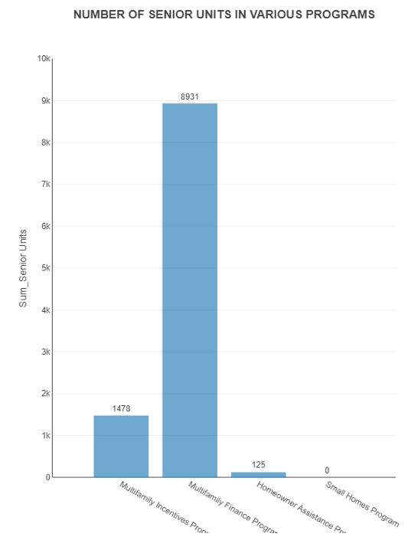
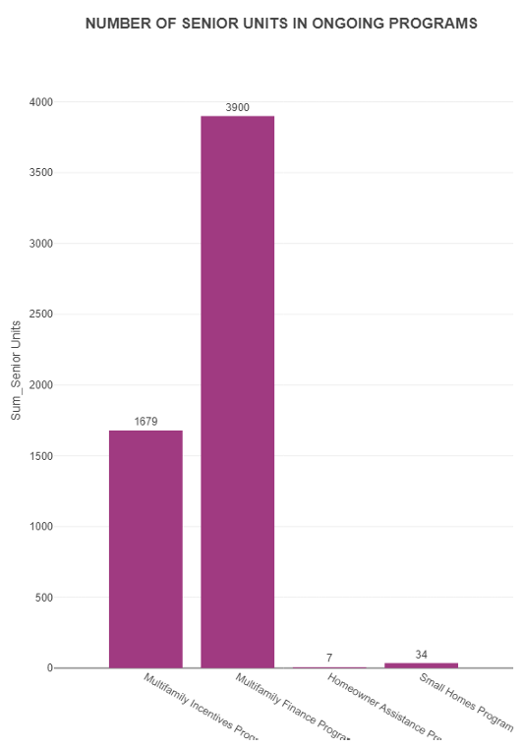
Priority of Senior Housing
With a considerable number of senior units created, there’s an evident prioritization for senior housing within the Multifamily Finance Program, reflecting a commitment to supporting this demographic.

Slide 7





2.
The effectiveness of the Small Homes Program reveals the potential of small-scale projects to deliver results cost-efficiently. This insight suggests an opportunity to scale this model to maximize impact.
1.
The success of the Multifamily Finance Program in unit production exemplifies the impact of strategic fund allocation and should serve as a model for optimizing resource distribution in other programs.
B
A
3.
5.
The preponderance of rental units indicates a targeted strategy aligned with current market demands. This trend highlights the importance of flexible housing solutions adaptable to changing economic landscapes.
INSIGHTS
The dominance of non-prevailing wage projects raises questions about labor policy's role in housing affordability. A detailed analysis could uncover ways to balance fair labor practices with project feasibility.
C
E
4.
D
The Multifamily Incentives Program has a smaller total unit output compared to the Finance Program, prompting a review of the incentive structures to ensure they are adequately boosting production.

Slide 8


THANK YOU

Slide 10
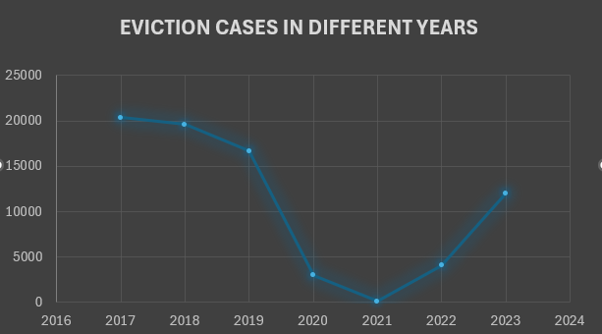
Eviction
Eviction plays a significant role in exacerbating the issue of homelessness.
Observations indicate a marked rise in eviction cases following the period impacted by the COVID-19 pandemic.
This trend underscores the importance of addressing evictions in efforts to mitigate homelessness.

Slide 11
Total Projects in Different Programs

Slide 12
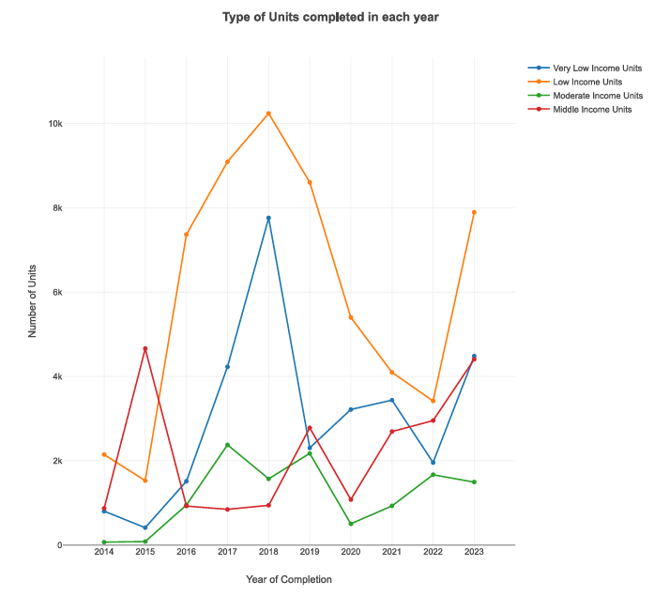
Units Completed in Each Year
The graph shows the number of different units completed in each year
This says the housings that are available are pretty less as compared tohomeless population in NYC

Slide 13
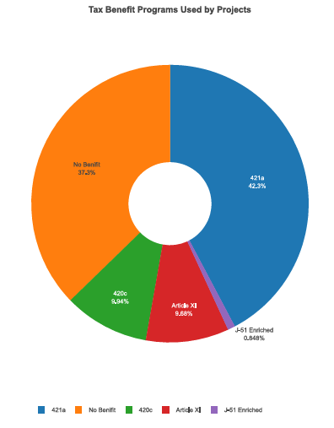
Tax Benifits
421 A is popular among the major project developers.
Major chuck of developers do not use Tax Benefits.

